Slide 1
Input New Location:
Latitude, Longitude, Date-time P[x, y, d]
Start here
Hour Changed?
NO
Append(Latitude, Longitude, Date-time) in Last hour points ->
lst_hr_pts[x, y, d] <- P[x, y, d]
YES
stay-points detection
in lst_hr_pts[x, y, d]
Group stay-points to form states (Using DB to snap the stay-points)
States
Calculate Markov Chain Model on States
Create time-slotted data (Hourly State Weights)
Calculate transition matrix for the day passed.
NO
Date Changed?
YES

Slide 2


Location Data of Few Weeks
Suggested
Application
Location-based Services
Create Prediction Model
PRE
Application
Visualize Privacy Threat
Phone
PRE Application
User

Slide 3
Hour t
4 5 6 7 8 9 10 11
Location Coordinates
Stay-points
sp₁ | sp₂ | …
States
st₁ | st₂ | …
Hour t
5 6 7 8 9 10 11
Time-slotted data
st₁, st₂ |  |  |  | st₂ | st₂
Markov Chain
… | …
mc₄ | mc₅ | mc₆ | mc₇ | mc₈ | mc₉ | mc₁₀ | mc₁₁ | mc₁₂ | mc₁₃
… | …

Slide 4
p4
p1
p3
p4
p1
p3
st₁
st₂
st₁
st₂
p2
p2
p5
p6
st₃
p9
p7
p8

Slide 5

home
home
Missing location data
18:00
06:00
hour
x = 0 Kms
t = 12 hours
Day 1
Day 2

Slide 6

home
work
Missing location data
7:00
8:00
hour
x = 6 Kms
t = 1 hour

Slide 7
GPS Trajectory Points
Markov Model
Stay-points Detection
Next Location Prediction
State Transitions
State Formation
Time-slotted States

Slide 8



Slide 9
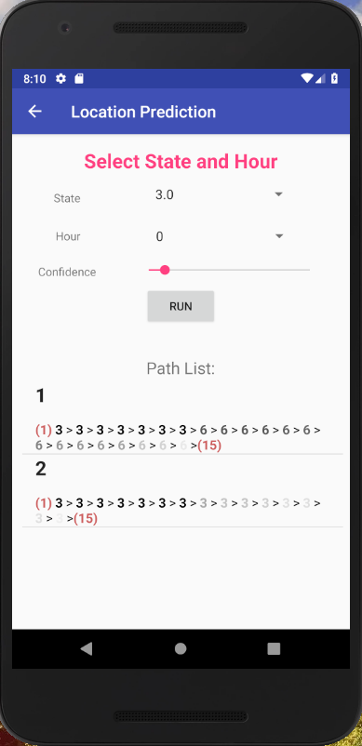


Slide 10
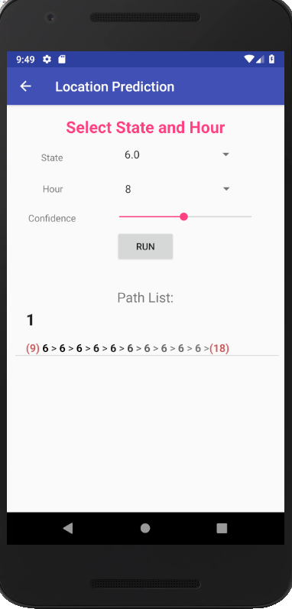
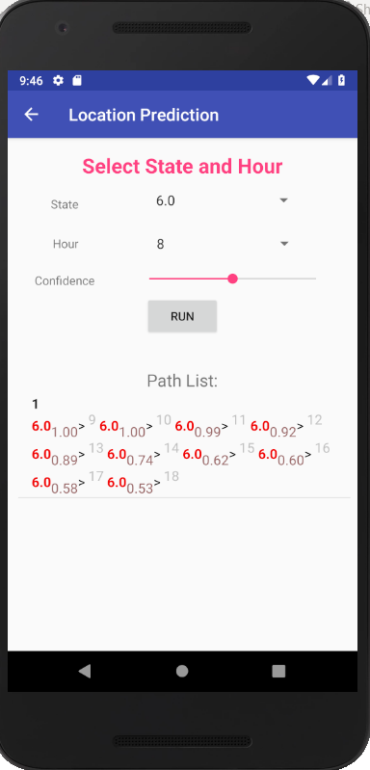

Slide 11
Hour t
4 5 6 7 8 9 10 11
st₁
st₂
st₃
Hour t
4 5 6 7 8 9 10 11
st₁
st₂
st₃
st₁ = 60/60 = 1
st₁ = 10/60 = 0.17
st₂ = 35/60 = 0.58

Slide 12
0.77
0.23
0
st₁
st₂
0
Hour t
4 5 6 7 8 9 10 11
st₁
st₂
st₃
st₁ = 1/1 = 1
st₁ = 0.17/0.75 =
0.23
st₂ = 0.58/0.75 =
0.77

Slide 13
1
0
0
 | st₁ | st₂ | st₃
st₁ | 0.23 | 0.77 | 0
st₂ | 0 | 0 | 0
st₃ | 0 | 0 | 0
0.23 0.77 0

Slide 14
t
st₁ st₂
t
st₁ st₂
w₁
w₂
w₁*w₁ | w₁*w₂
w₂*w₁ | w₂*w₂
w₁ w₂
st₁ st₂
0.33 | 0.67
0 | 0
st₁ st₂
1
t=5
st₁ st₂ st₃
t=5
st₁ st₂ st₃
t=5
st₁ st₂ st₃
2
3
0.33 | 0.67 | 0
0.33 | 0.67 | 0.00001
0.3299 | 0.6699 | 9.99x10⁻⁶
st₁ ₋₋₋₋₋₋₋₋
State transition weights
st₁ ₋₋₋₋₋₋
State transition weights
with 0 replaced with small weight
st₁ ₋₋₋₋₋
Transition probabilities

Slide 15
t
st₁ st₂
w₁
w₂
trn_mat_{t} = w^{t-1T}.w^{t} =
w₁ w₂
w₁*w₁ | w₁*w₂
w₂*w₁ | w₂*w₂
*
=
st₁ st₂
t
st₁ st₂
p₁₁ | p₁₂
p₂₁ | p₂₂
mc_{t} = Normalize[ (day 1)trn_mat_{t} + (day 2)trn_mat_{t} + …. ] =
st₁ st₂
1
t=5
st₁ st₂ st₃
t=5
st₁ st₂ st₃
t=5
st₁ st₂ st₃
2
3
0.33 | 0.67 | 0
0.33 | 0.67 | 0.00001
0.3299 | 0.6699 | 9.99x10⁻⁶
st₁ ₋₋₋₋₋₋₋₋
State transition weights
st₁ ₋₋₋₋₋₋
State transition weights
with 0 replaced with small weight
st₁ ₋₋₋₋₋
Transition probabilities

Slide 16
Snapping same stay-points to form states
Hour t
4 5 6 7 8 9 10 11
STAYPOINTS
SP1
SP2
SP3
SP4
STAYPOINTS
Hour t
4 5 6 7 8 9 10 11
STATES
ST1
ST2
ST1
ST2
STATES
Hour t
4 5 6 7 8 9 10 11
STATE WEIGHTS
W_{ST1}=
0.6667
W_{ST2}=
0.6667
W_{ST2}=
0.9167
W_{ST1}=
0.6667
W_{ST1}=
0.4167
W_{ST2}=
0.4167
W_{ST2}=1
W_{ST2}=0.333
STATE WEIGHTS

Slide 17
Location Coordinates
Snapping same stay-points to form states
Hour t
4 5 6 7 8 9 10 11
STAYPOINTS
STAYPOINTS
Stay-points
Hour t
4 5 6 7 8 9 10 11
STATES
st₁
st₁
STATES
States

Slide 18
State hourly weight
Hour t
4 5 6 7 8 9 10 11
STATE WEIGHTS
W={
0.67}
W={
0.92}
W={0.42}
W={0.33}
STATE WEIGHTS
Hour t
4 5 6 7 8 9 10 11
N-STATE WEIGHTS
W={1}
W={1}
W={1}
W={1}
N-STATE WEIGHTS
Normalized State hourly weight

Slide 19
STAYPOINTS
Hour t
40
4 5 6
60
20
STATES
STATE
st₁
st₁
st₂
STATE
Hour t
4 5 6
STATE WEIGHTS
W₁=1
W₁=
0.33
W₂=
0.67
STATE WEIGHTS

Slide 20
State Hourly Weights
…
W_{ST1(4)} = (04:45 - 04:05).minutes/60 = 40/60 = 0.6667
W_{ST2(4)} = 0
W_{ST1(5)} = 0
W_{ST2(5)} = (06:00 - 05:20).minutes/60 = 40/60 = 0.6667
W_{ST1(6)} = 0
W_{ST2(6)} = (06:55 – 06:00).minutes/60 = 55/60 = 0.9167
W_{ST1(7)} = (08:00 – 07:20).minutes/60 = 40/60 = 0.6667
W_{ST2(7)} = 0
W_{ST1(8)} = (08:25 – 08:00).minutes/60 = 25/60 = 0.4167
W_{ST2(8)} = (09:00 – 08:35).minutes/60 = 25/60 = 0.4167
W_{ST1(9)} = 0
W_{ST2(9)} = (10:00 – 09:00).minutes/60 = 60/60 = 1
W_{ST1(10)} = 0
W_{ST2(10)} = (10:20 - 10:00).minutes/60 = 20/60 = 0.3333
…

Slide 21
Hourly Matrix
STATES-> ST1 ST2
t₄ = [ 0.6667 0 ]
t₅ = [ 0 0.6667 ]
t₆ = [ 0 0.9167 ]
t₇ = [ 0.6667 0 ]
t₈ = [ 0.4167 0.4167 ]
t₉ = [ 0 1 ]
t₁₀ = [ 0 0.3333 ]
ST1
ST2
ST1 | ST2
0.6667
0
t₄₋₅=
0 | 0.6667
ST1 | ST2
ST1
ST2
0 | 0.4445
0 | 0
t₄₋₅=
Markov Chain t₄₋₅
0.4445
0
0
ST1
ST2
0

Slide 22


Slide 23
11 am
10 am
8 am
5 pm
7 am
6 pm
“home”
“gym”
“cafe”
“work”
1
2
3
4
Hour t
7 8 9 10 11 12 13 14 15 16 17 18 19
“home”
“gym”
“gym”
“cafe”
“work”
“work”
“work”
“work”
“work”
“work”
“cafe”
“home”
1
2
2
3
4
4
4
4
4
4
3
1

Slide 24
Hour t
7 8 9 10 11 12 13 14 15 16 17 18 19
“home”
“gym”
“gym”
“cafe”
“work”
“work”
“work”
“work”
“work”
“work”
“cafe”
“home”
1
2
2
3
4
4
4
4
4
4
3
1

Slide 25
th_d
state st_{i}
new stay-point sp_{j}
state st_{i} new mean
state st_{i} current mean

Slide 26
th_d
th_d
stay-point “home”
stay-point “home” mean
new stay-point “work”
stay-point “work’ mean
travelling from “home” to “work”

Slide 27
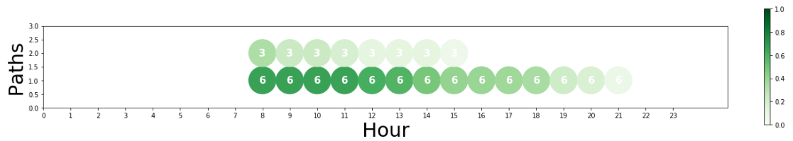
“work”
“home”
Confidence

Slide 28
t t+1 t+2
hour
p₁
p₂
p₃
p₄
p₅
.
.
p₁
p₂
p₃
p₄
p₅
.
.
p_{i}
p₁
p₂
p₃
p₄
p₅
.
.
Path 1
i
1
5
Path 2
i
1
4

Slide 29
t t+1 t+2
hour
.
.
.
.
.
.
.
p_{i1}
p_{i2}
p_{i3}
p_{i4}
p_{i5}
.
p_{ij}
.
State st_{i}
.
.
.
.
.
.
.
(P_{ii}*p_{ij})
Path 1
i
j

Slide 30
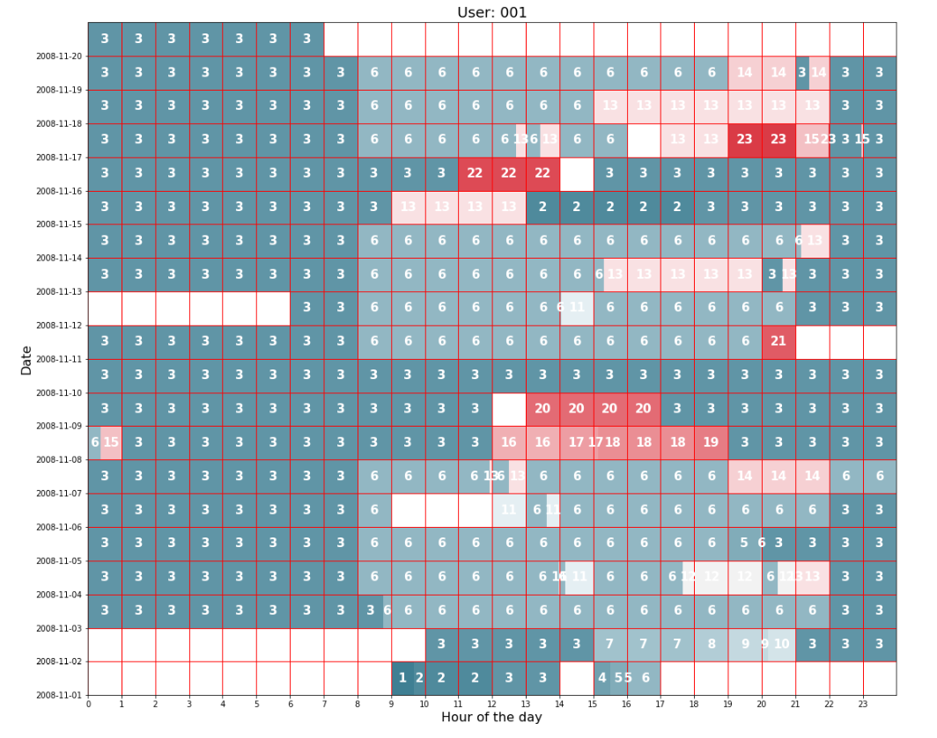

Slide 31
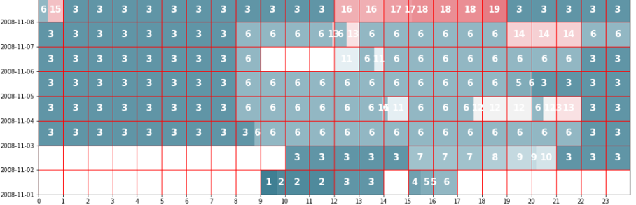
Day
Hour

Slide 32
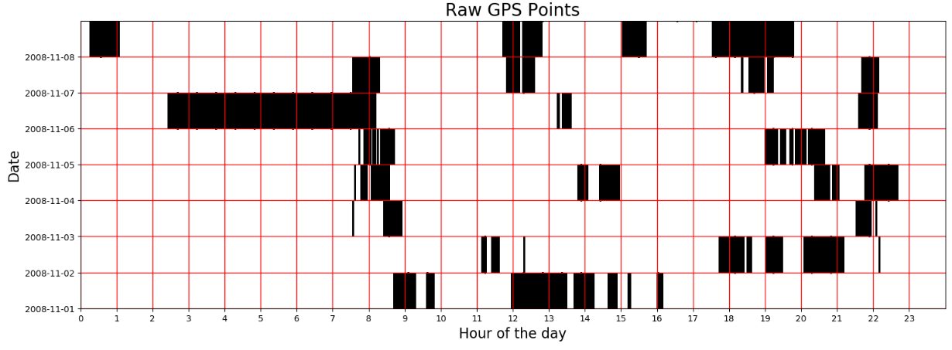

Slide 33
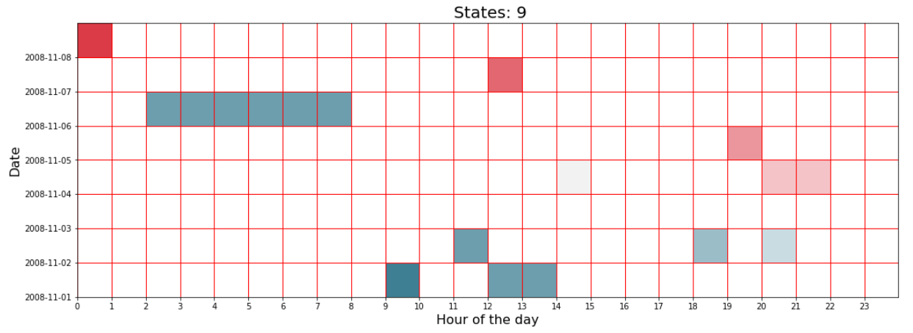

Slide 34
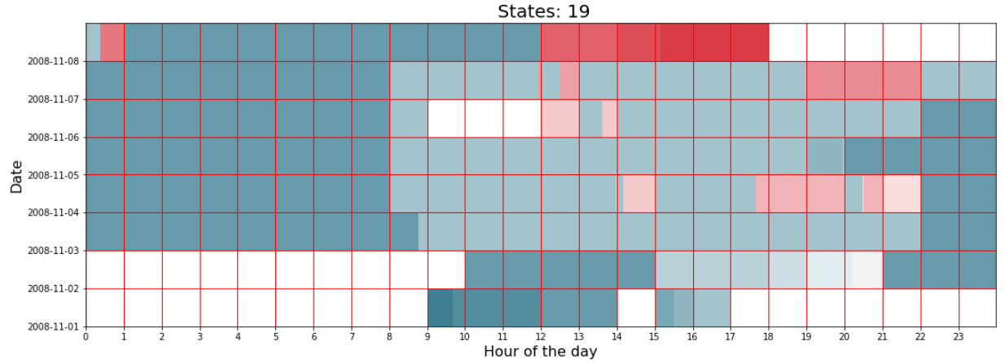

Slide 35
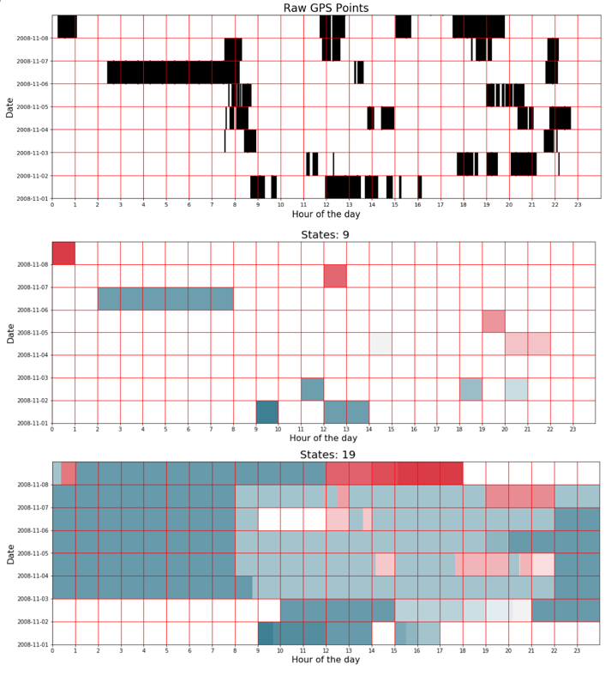

Slide 36
Correct Prediction
Incorrect Prediction
Prediction Not Counted
Predicted transition
Predicted transition
Predicted transition
5 6 7
5 6 7
Hour t
5 6 7
st₁
st₂
st₃
st₁
st₂
st₃
st₁
st₂
Training
Training
Hour t
5 6 7
5 6 7
5 6 7
Test
st₁
st₂
st₁
st₂
st₁
Test
Missing data
Ground Truth
Ground Truth
Ground Truth

Slide 37
Prediction Made
Prediction Not Made
Predicted transition
Predicted transition
5 6 7
5 6 7
Hour t
Training
st₁
st_{n}
st₁
st_{n}
Training
Hour t
5 6 7
5 6 7
Test
st₁
st_{k}
st_{new}
st_{k}
Test
Actual transition
Actual transition

Slide 38
1
P =
p₁ p₂ p₃ p₄ p₅
2
newP =
max(p₁-mlf,0) max(p₂-mlf,0) max(p₃-mlf,0) max(p₄-mlf,0) max(p₅-mlf,0)
t
newP₁ / sum(newP)
newP₂ / sum(newP)
newP₃ / sum(newP)
newP₄ / sum(newP)
newP₅ / sum(newP)
3
normP =

Slide 39
mlf = 0.05
1
P =
0.79 0.12 0.03 0.03 0.03
2
newP =
0.74 0.07 0 0 0
3
normP =
0.91 0.09 0 0 0

Slide 40
st = {st₁, st₂, …st_{n}}
p = {p₁, p₂, … p_{n}}
sp = {sp_{1,} sp₂, … sp_{n}}
w = {w₁, w_{2, …} w_{k}}

Slide 41
